Slide 1

Global Bike Inc. (GBI)
Company History
John Davis and Peter Weiss are co-CEOs
Operations in the United States (US) and Germany (DE)
The Business
Professional and prosumer cyclist market
GBI sells high quality bicycles and cycling accessories
Sells to retailer partners, not to the consumer directly

Slide 2
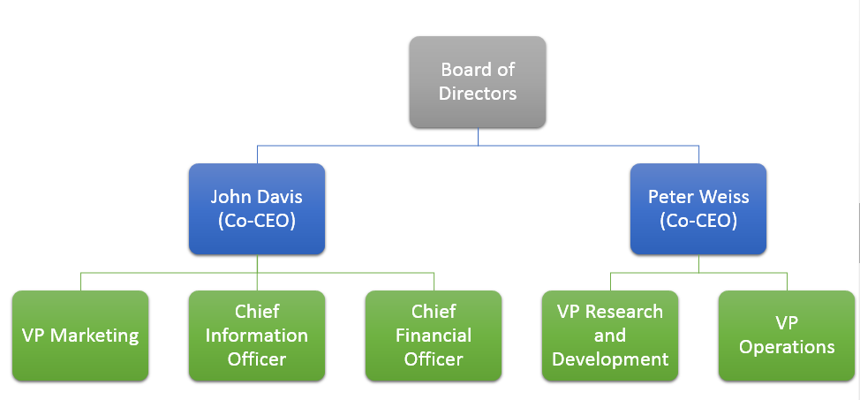
GBI Organizational Structure

Slide 3
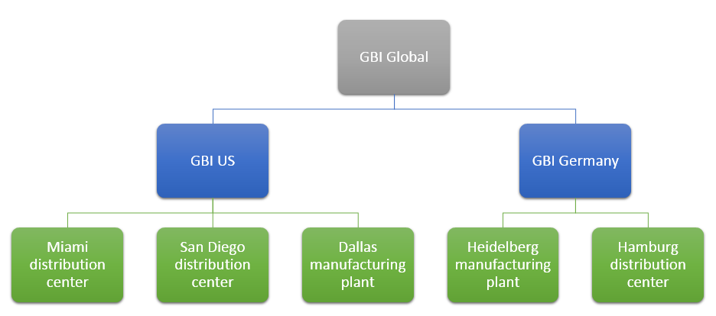
GBI Business Structure

Slide 4
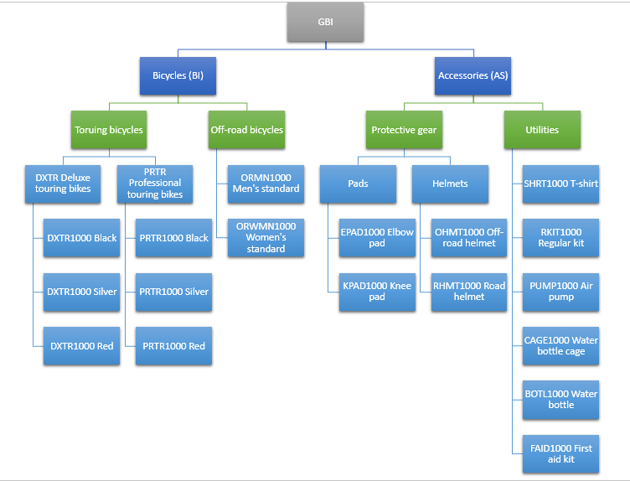
GBI Products

Slide 5
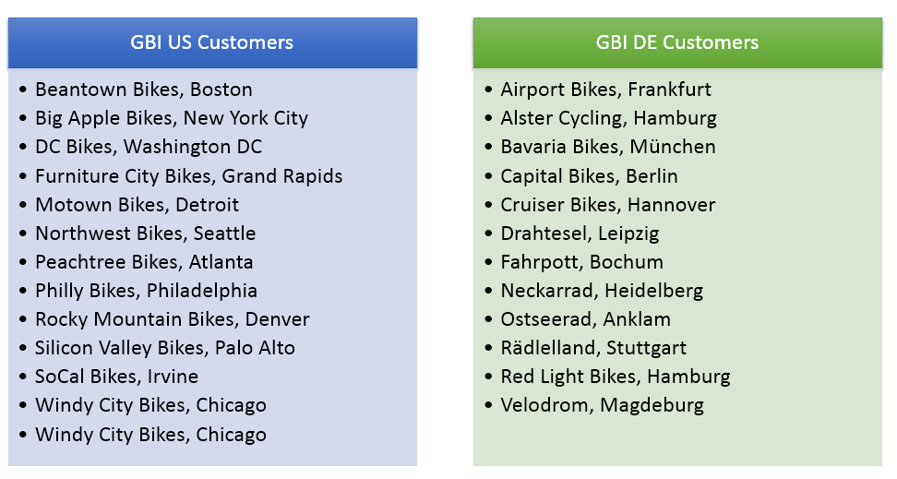
GBI Customers

Slide 6
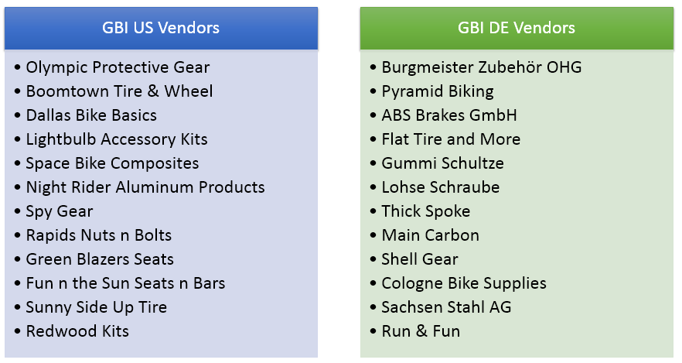
GBI Vendors (Suppliers)

Slide 7
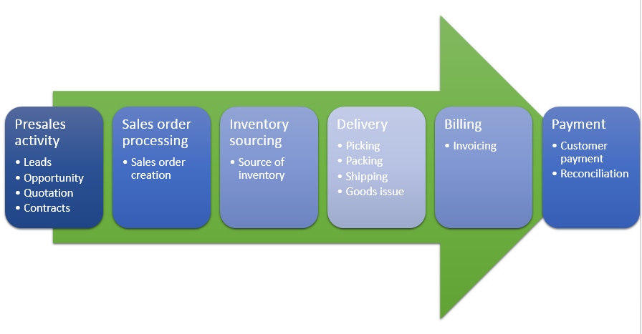
GBI – Sample Business Process

Slide 8
Some GBI Employees and Their Business Questions
Nina Kane – U.S. Sales Manager
How do I anticipate and compete with new competitors for market share in the prosumer bike market?
What data do I need to evaluate sales, discover trends, and identify opportunities?
How can I motivate my sales team?
Is there value in organizing invitation-only promotional events for our loyal customers?
Are there any delays in our supply chain that have led to lost sales?
Donna Vasant – Business Analyst
Are there new markets for GBI products?
Are there new products that GBI could bring to the market? How about bike-integrated video cameras, body-monitoring devices, and a bike trolley to carry pets, babies, and groceries, especially in urban areas?
Is an electric bike a viable and profitable new product?
Are internet sales the future for high-end bikes (instead of or in addition to retail stores)? Will internet sales compete with our loyal customers (distributors)?

Slide 9
Some GBI Employees and Their Business Questions
Jessi Mard – Controller
Are profit margins in line with expectations?
Are operational efficiencies affecting profitability?
How can we encourage customers to pay more quickly?
How well can we forecast cash flows and other key accounting indicators?
Are our internal accounting controls effective?
Peter Pollard – Production Manager
How can we become more efficient in the manufacturing processes?
Is the quality of raw materials affecting production?
Can the manufacturing plant meet sales demand?
Is the manufacturing facility set up to reduce unnecessary material movements and encourage efficiency in the production process?

Slide 10
Some GBI Employees and Their Business Questions
Tony Liu – Shipping Personnel
What percentage of orders are shipping within 24 hours of order receipt?
Bruce Hewlett – Shipping Manager
How many orders have not shipped within 24 hours of receipt and why?
How many products were damaged during the packing and shipping process?
Did any orders ship to the incorrect customer or address?
How many orders were damaged by the shipping company?
How many orders did not arrive at the customer’s site on time due to shipping problems and how can those problems be avoided in the future?

